Slide 1
Problem:
If I have a group of 100 applicants for a college summer program whose mean SAT-Verbal is 525, is this group of applicants “above national average”?

Slide 2
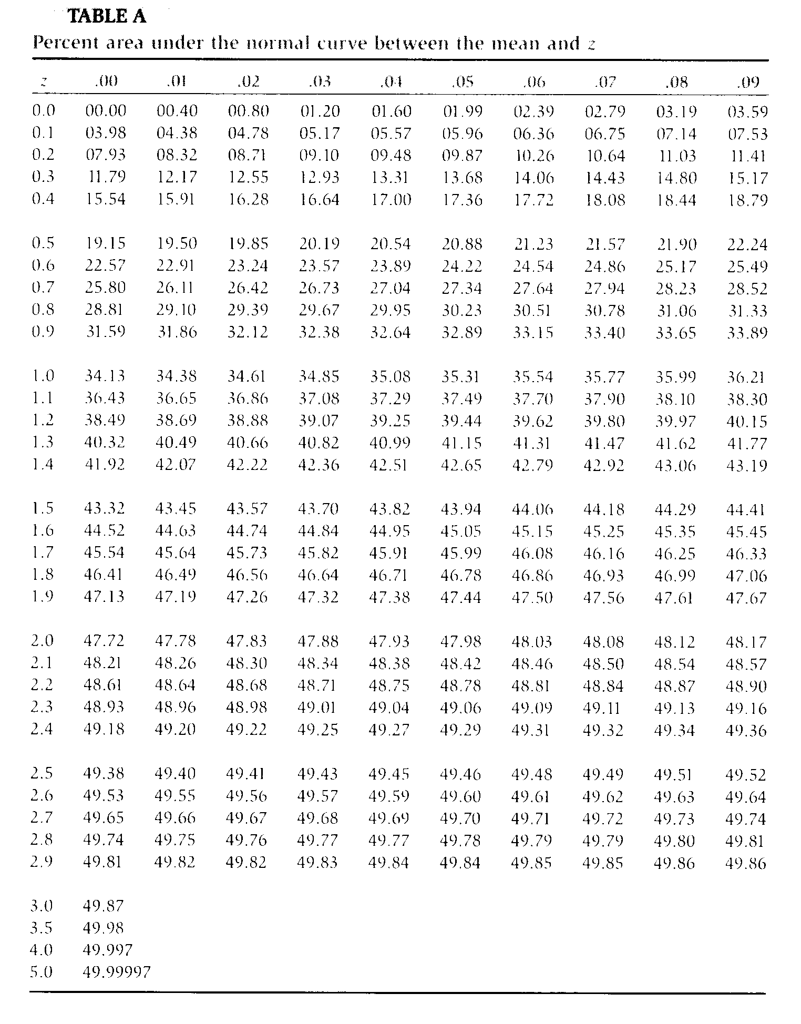

Slide 3
Problem:
If I have a group of 100 applicants for a college summer program whose mean SAT-Verbal is 525, is this group of applicants “above national average”?
Can I come up with a confidence interval for the “true value” of the population from which this group of applicants was drawn?

Slide 5


Slide 6

GOSSET, William Sealy 1876-1937

Slide 7
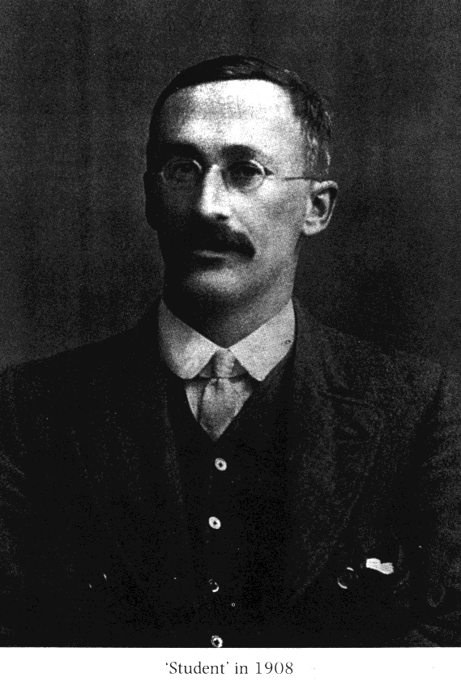
GOSSET, William Sealy 1876-1937

Slide 8


GOSSET, William Sealy 1876-1937

Slide 9
The t-distribution is a family of distributions varying by degrees of freedom (d.f., where
d.f.=n-1). At d.f. = ∞, but at smaller than that, the tails are fatter.

Slide 10
_
X - μ
z =
-
σ_{X}
_
X - μ
t =
-
s_{X}
s
-
s_{X} =
√ N

Slide 11
The t-distribution is a family of distributions varying by degrees of freedom (d.f., where
d.f.=n-1). At d.f. = ∞, but at smaller than that, the tails are fatter.

Slide 12
Degrees of Freedom
df = N - 1

Slide 13
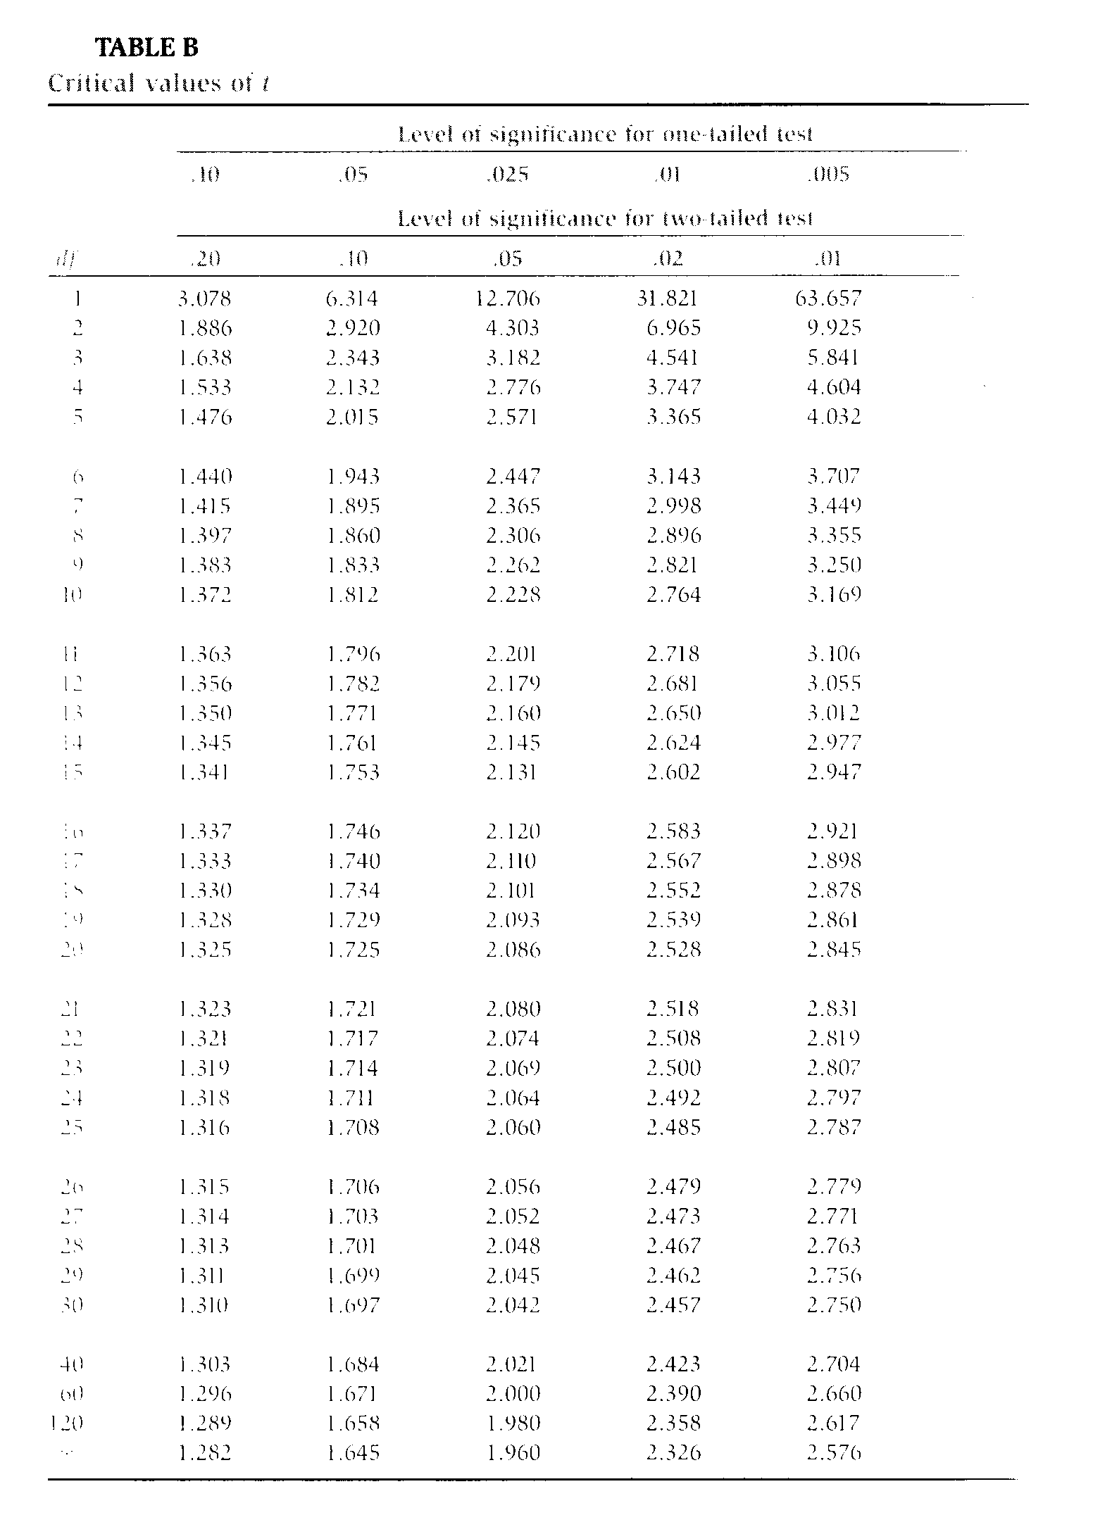

Slide 15
Problem
Sample:
Mean = 54.2
SD = 2.4
N = 16
Do you think that this sample could have been drawn from a population with μ = 50?

Slide 16
Problem
Sample:
Mean = 54.2
SD = 2.4
N = 16
Do you think that this sample could have been drawn from a population with μ = 50?
_
X - μ
t =
-
s_{X}

Slide 17
The mean for the sample of 54.2 (sd = 2.4) was significantly different from a hypothesized population mean of 50, t(15) = 7.0, p < .001.

Slide 18
The mean for the sample of 54.2 (sd = 2.4) was significantly reliably different from a hypothesized population mean of 50, t(15) = 7.0, p < .001.

